Slide 1


School of Engineering Technology and Applied Science
API Engineering
Reza Dibaj

Slide 2
ASP.NET Core

Slide 3
ASP.NET Core
It is a complete rewrite of ASP.NET
It features modular programming
It is lightweight for best use on the cloud
It is available to non-Microsoft platform
ASP.NET Web Form is no longer part of ASP.NET Core
More details about .NET platform can be found here

Slide 4
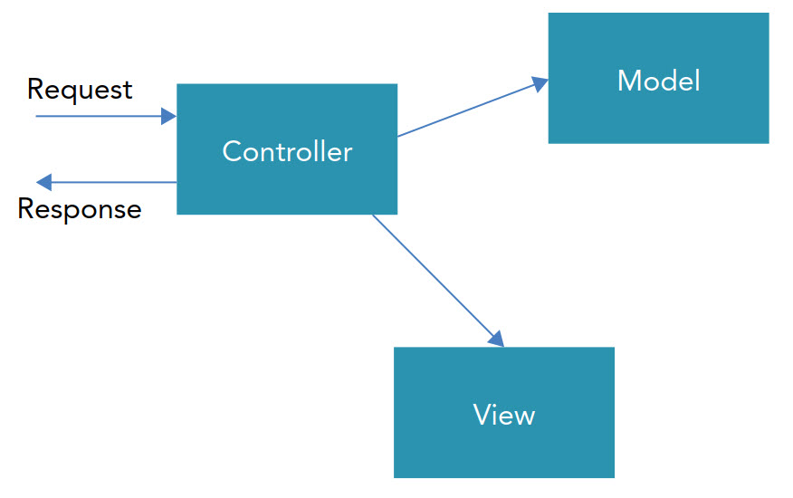
Model-View-Control (MVC)
Model
Implements data entities and data access
View
Represents the information shown to the user
Controller
Makes use of the model and sends data to the view
Notes:
Previously,
We had DB – ADO.NET -> ASP.NET
Now,
View (like ASP.Net Pages), another name for Razor Pages
just shows data
Model
responsible for taking care of data
Controller
everything happens under supervision of Controller
e.g. calculations, business logic, see who has which data (under supervision of Controller)
User sends request to controller, who then redirects to spcfc views, who may not have data and need to request it from certain models by asking the controller

Slide 5
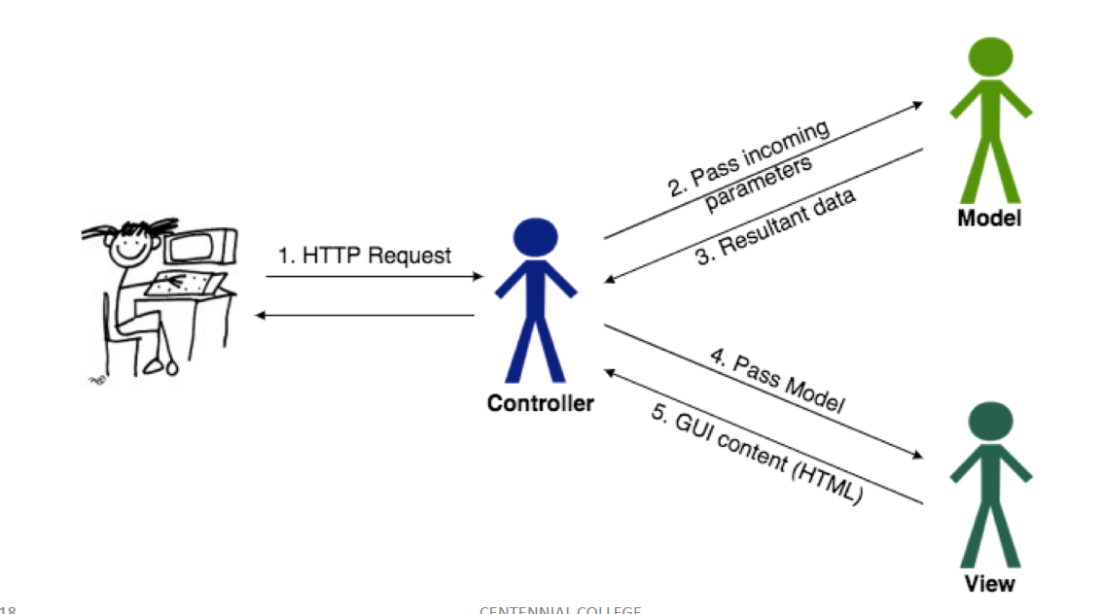
Model-View-Control (MVC)

Slide 6
Model-View-Control (MVC)

Slide 7
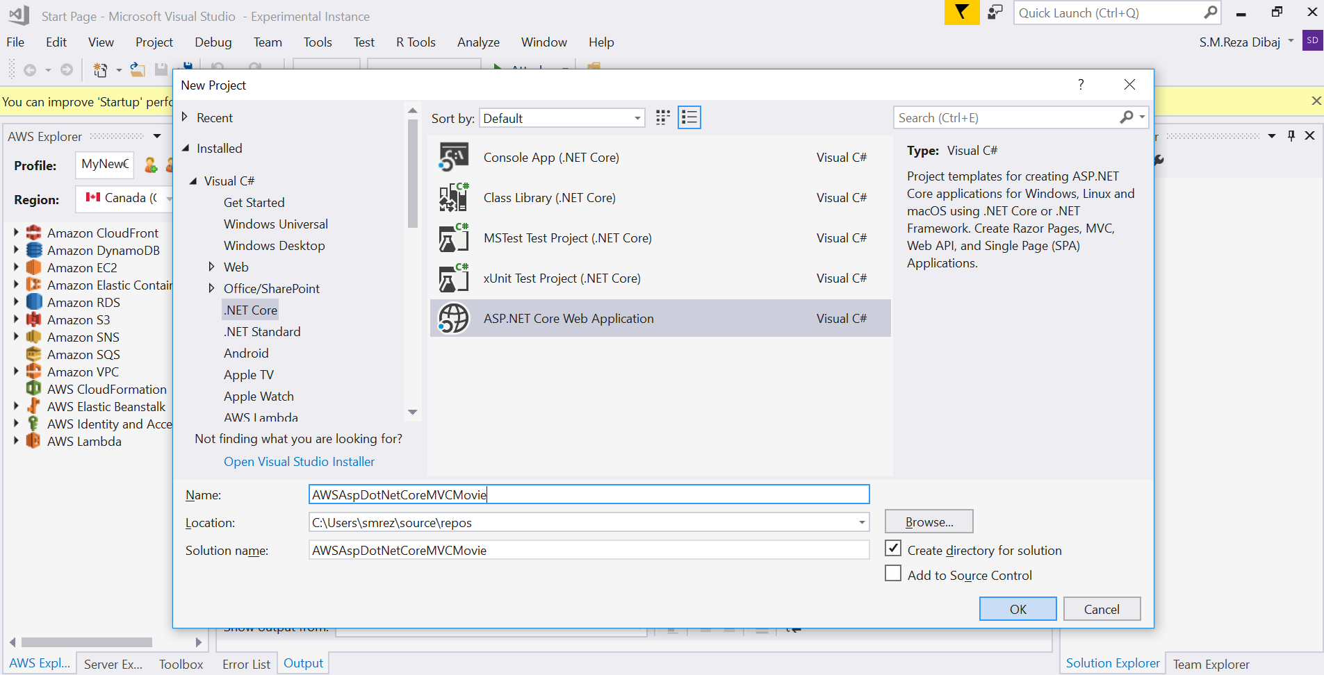
Develop ASP.NET Core Web App
Notes:
Project Name: AWSAspDotNetCoreMVCMovie

Slide 8
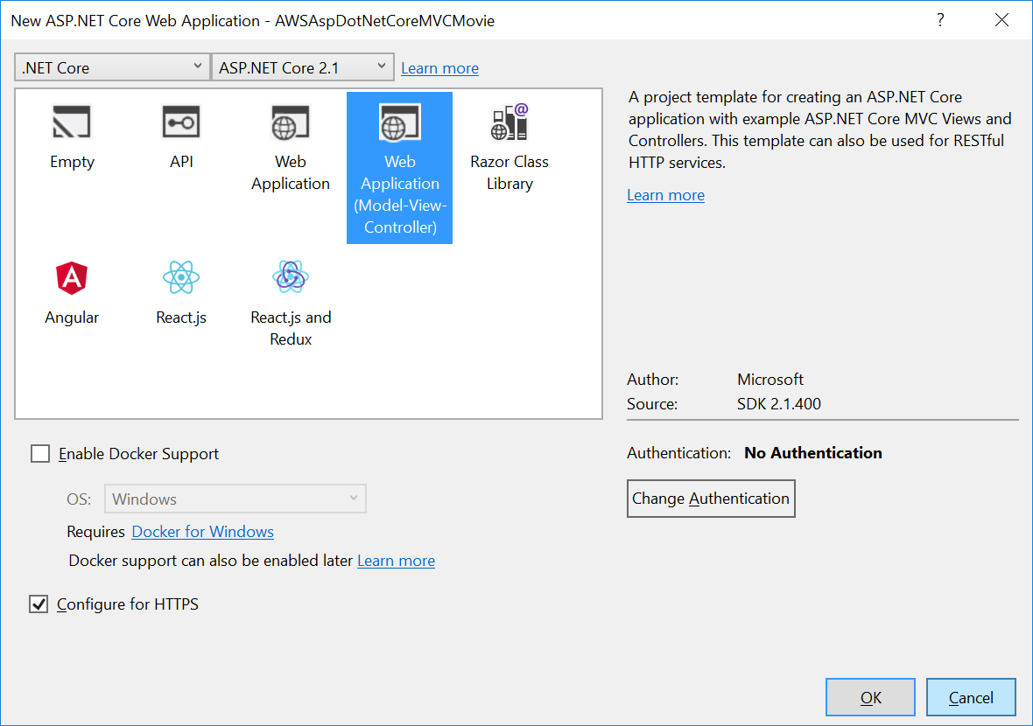
Develop ASP.NET Core Web App

Slide 9
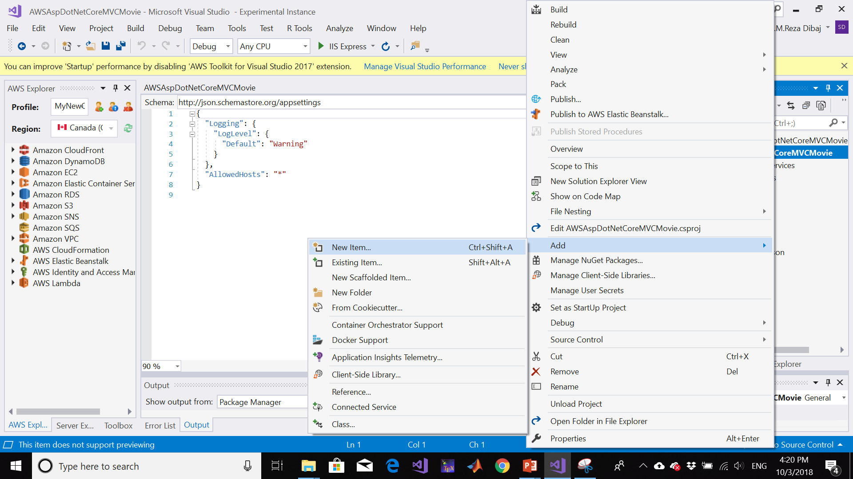
Take a closer Look at Solution

Slide 10
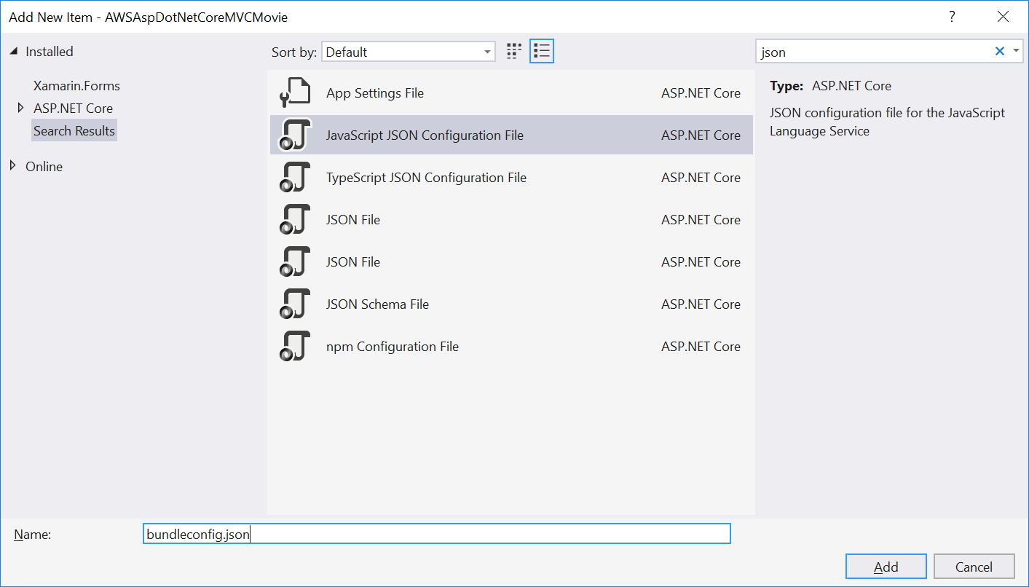
Take a closer Look at Solution
Notes:
bundleconfig.json

Slide 11
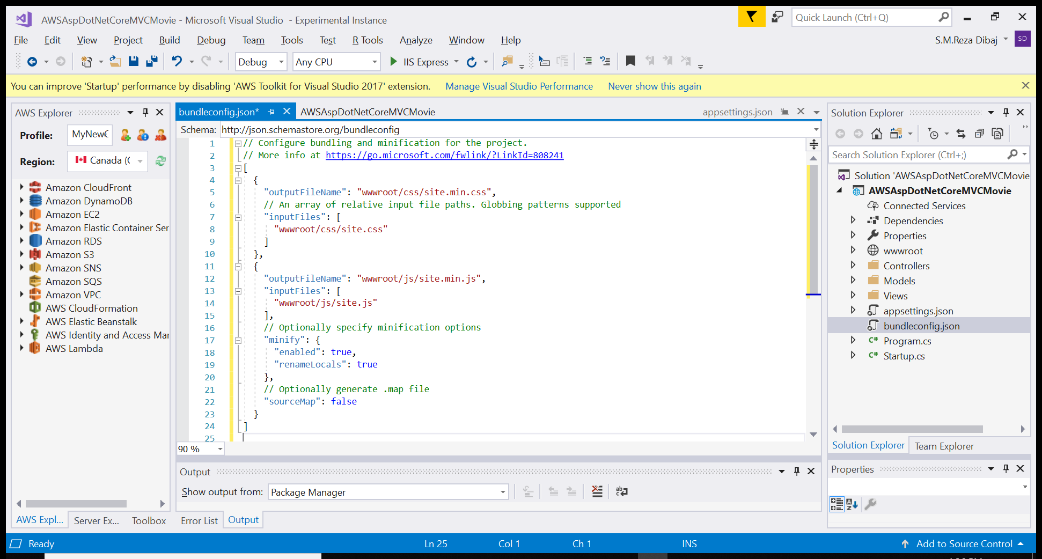
Take a closer Look at Solution
Notes:
// Configure bundling and minification for the project.
// More info at https://go.microsoft.com/fwlink/?LinkId=808241
[
{
"outputFileName": "wwwroot/css/site.min.css",
// An array of relative input file paths. Globbing patterns supported
"inputFiles": [
"wwwroot/css/site.css"
]
},
{
"outputFileName": "wwwroot/js/site.min.js",
"inputFiles": [
"wwwroot/js/site.js"
],
// Optionally specify minification options
"minify": {
"enabled": true,
"renameLocals": true
},
// Optionally generate .map file
"sourceMap": false
}
]

Slide 12
Take a closer Look at Solution
Minifying is to remove comments and whitespace, while bundling is to combine multiple files into one. bundleconfig.json file contains sections with outputFileName and inputFiles directives. The input files are minified and bundled to create one output file. E.g., you can add all css files to bundle into one css file, and all JavaScript files in the project to bundled into one JavaScription file.
launchingSettings.json file holds project specific settings associated with each profile (i.e., development, staging, production).
aspsettings.json contains configuration settings, and stores global values. It is similar to Web.config file.

Slide 13
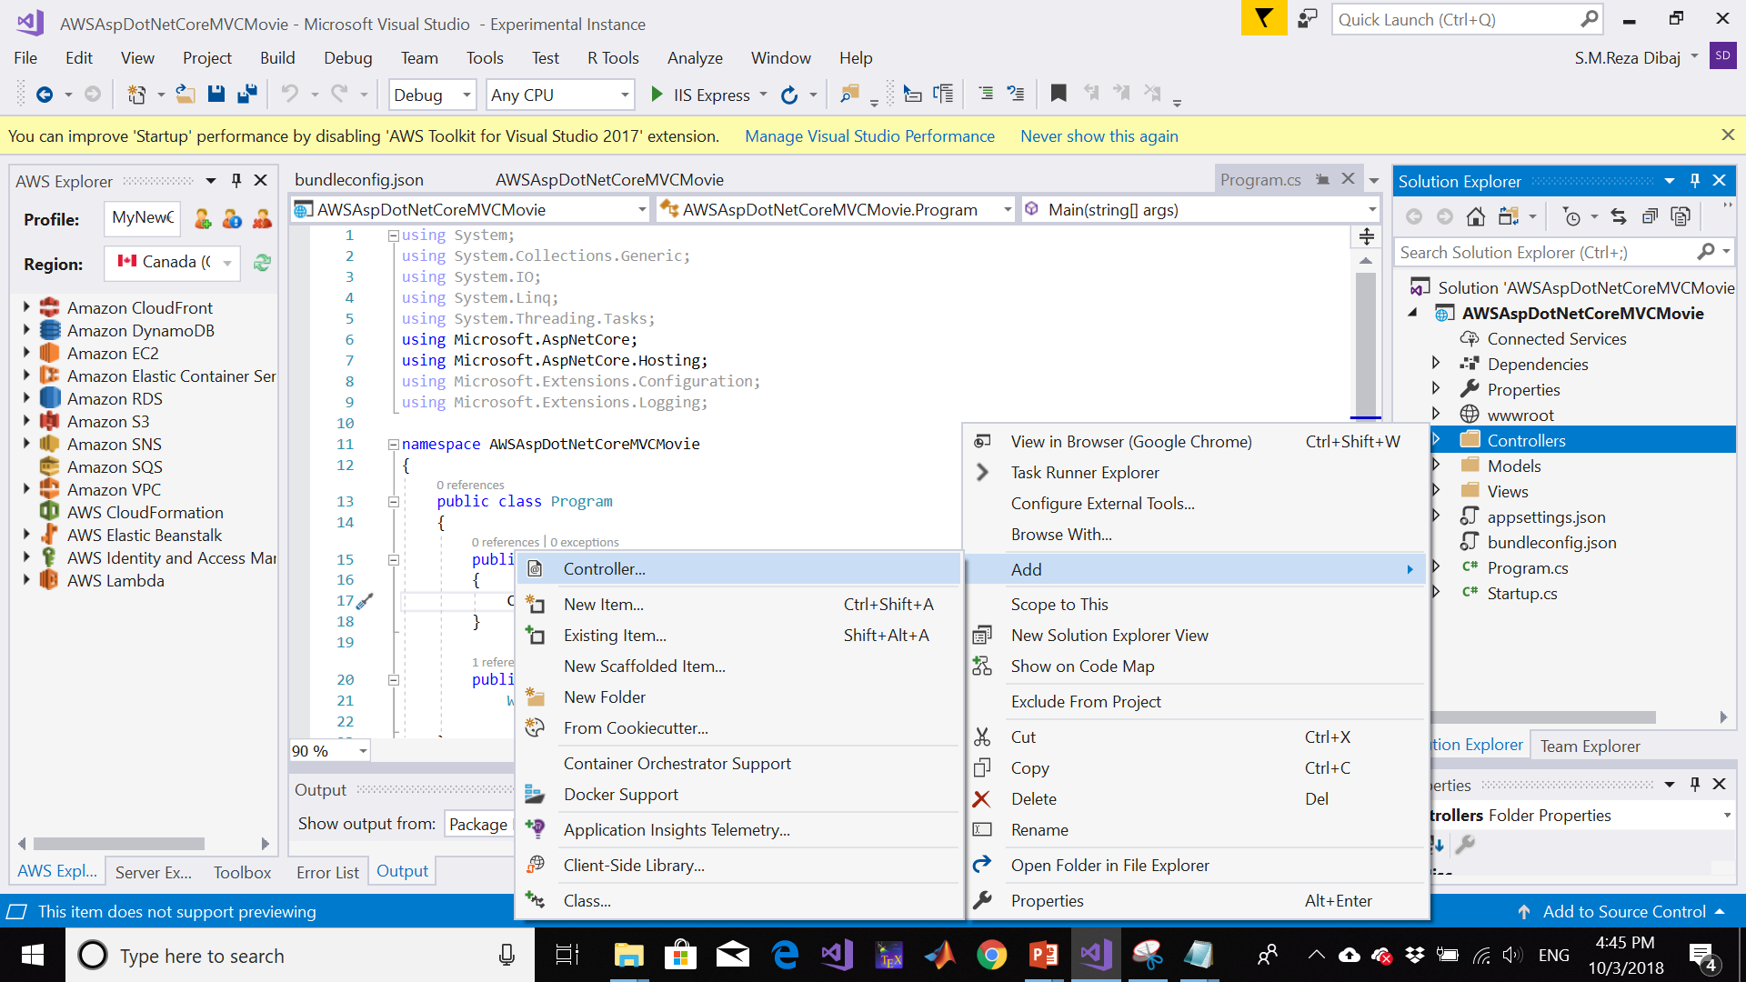
Add Controller

Slide 14
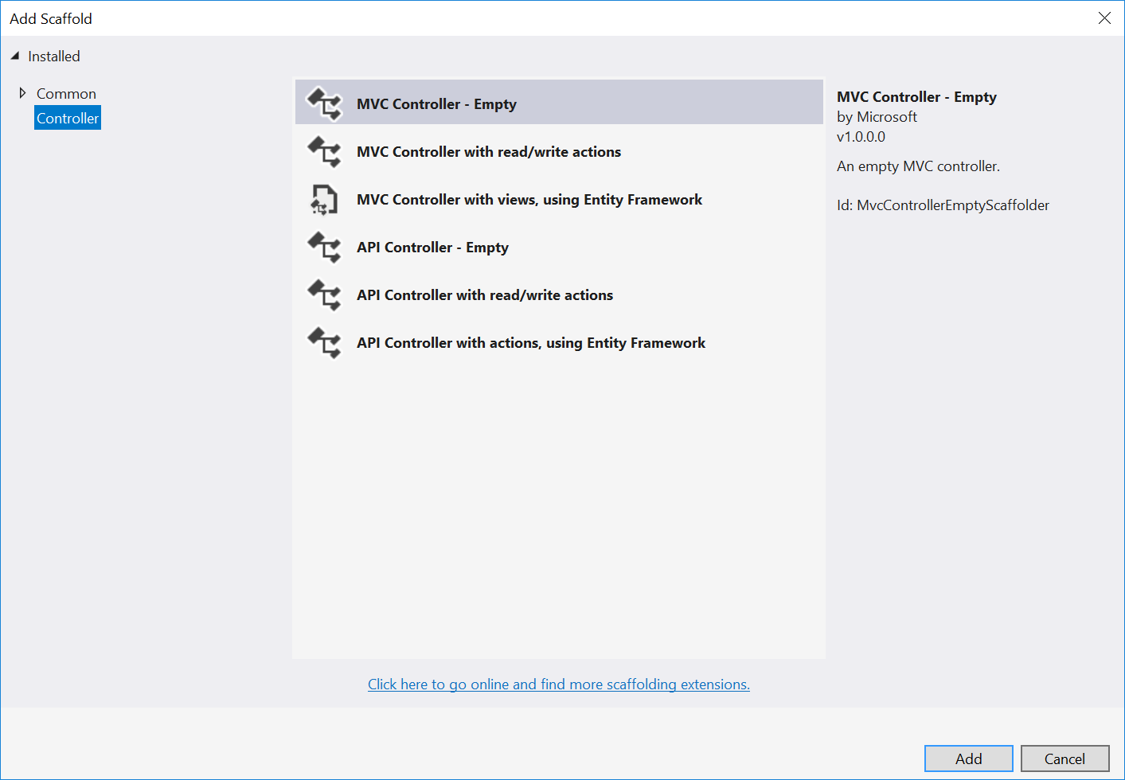
Add Controller
Notes:
HomeWorldController.cs

Slide 15
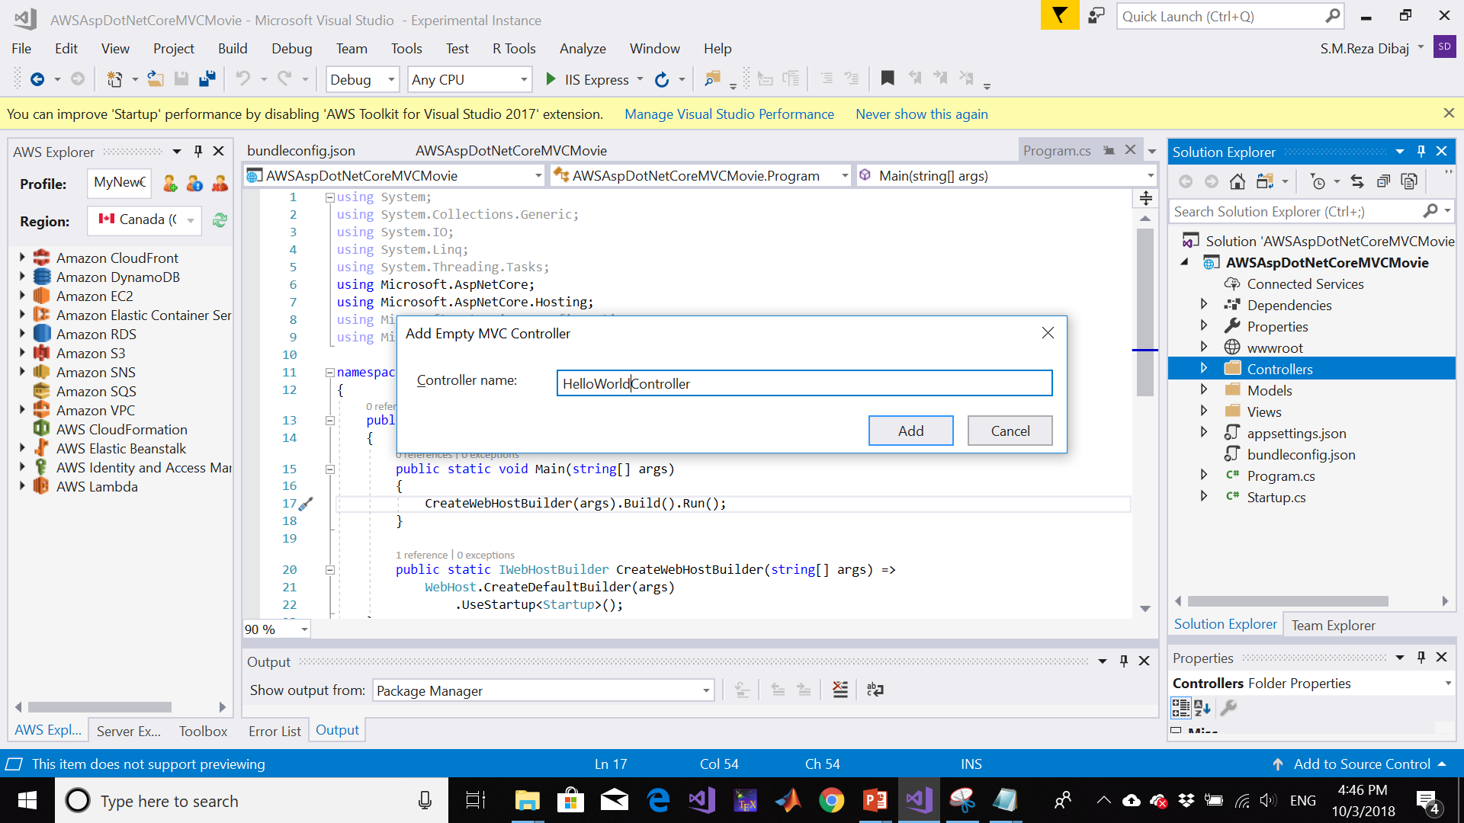
Add Controller
Notes:
HomeWorldController.cs

Slide 16
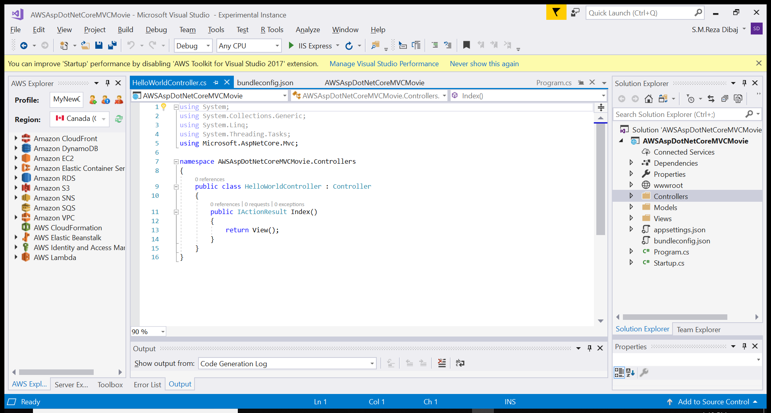
Add Controller
Notes:
HomeWorldController.cs

Slide 17
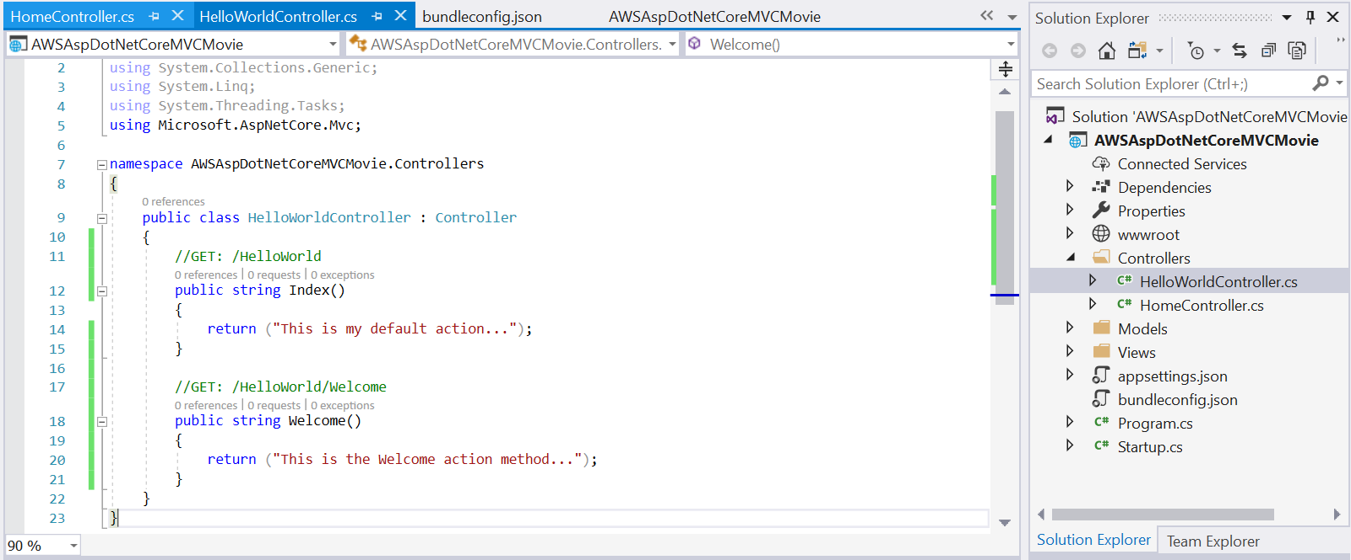
Add Controller
Every public method in a controller can be called as an HTTP endpoint
Notes:
using System;
using System.Collections.Generic;
using System.Linq;
using System.Threading.Tasks;
using Microsoft.AspNetCore.Mvc;
namespace AWSAspDotNetCoreMVCMovie.Controllers
{
public class HelloWorldController : Controller
{
//GET: /HelloWorld
public string Index()
{
return ("This is my default action...");
}
//GET: /HelloWorld/Welcome
public string Welcome()
{
return ("This is the Welcome action method...");
}
}
}

Slide 18

Let’s Run!

Slide 19
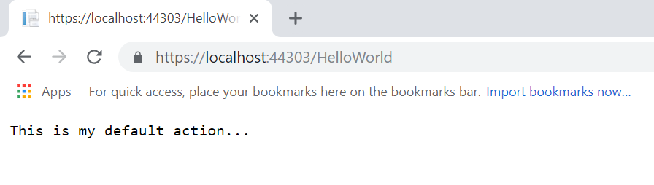
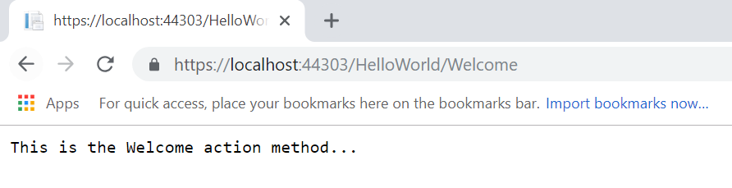
Running the code…

Slide 20
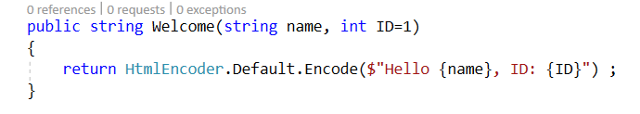
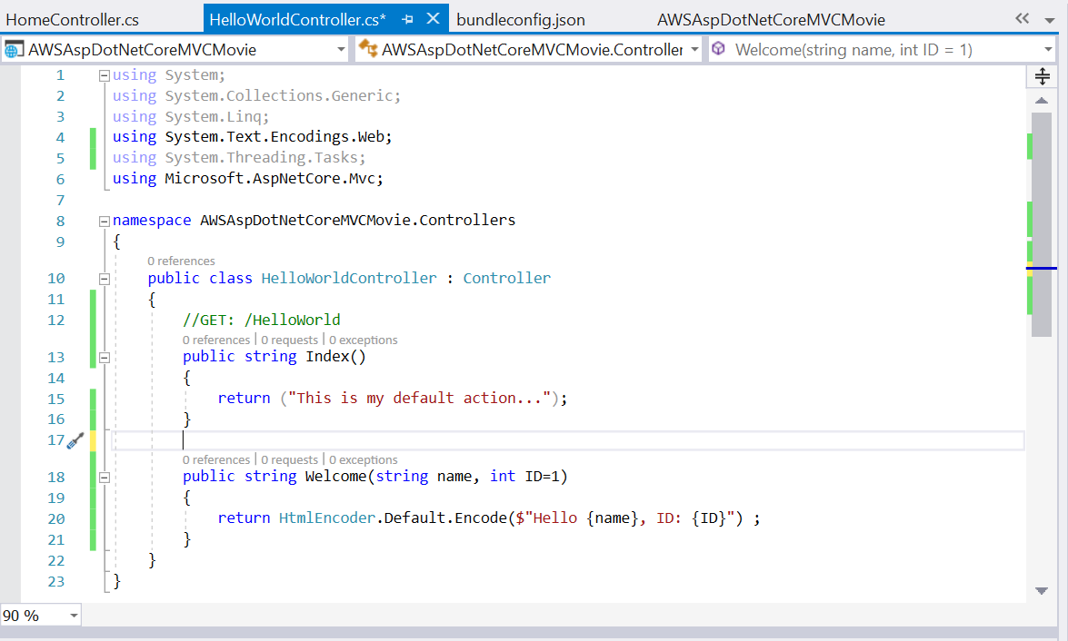
Modifying the controller…
Ctrl + . And add the needed library to the using collection
Notes:
using System;
using System.Collections.Generic;
using System.Linq;
using System.Text.Encodings.Web;
using System.Threading.Tasks;
using Microsoft.AspNetCore.Mvc;
namespace AWSAspDotNetCoreMVCMovie.Controllers
{
public class HelloWorldController : Controller
{
//GET: /HelloWorld
public string Index()
{
return ("This is my default action...");
}
public string Welcome(string name, int ID=1)
{
return HtmlEncoder.Default.Encode($"Hello {name}, ID: {ID}") ;
}
}
}

Slide 21
Let’s Run!

Slide 22
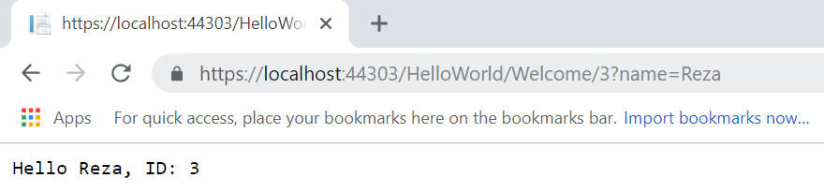
Running the code…

Slide 23
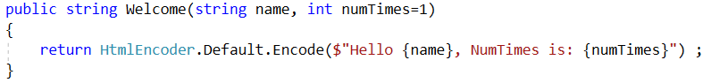
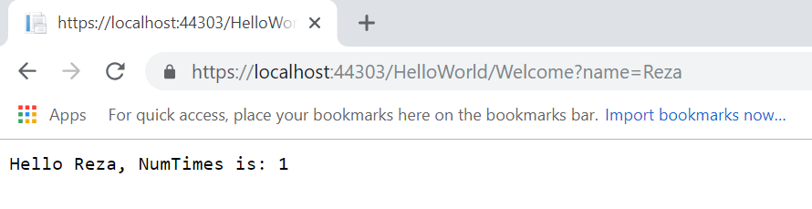
Modifying the controller and run it again…

Slide 24
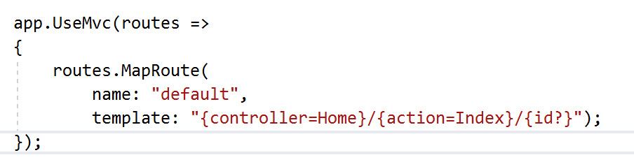
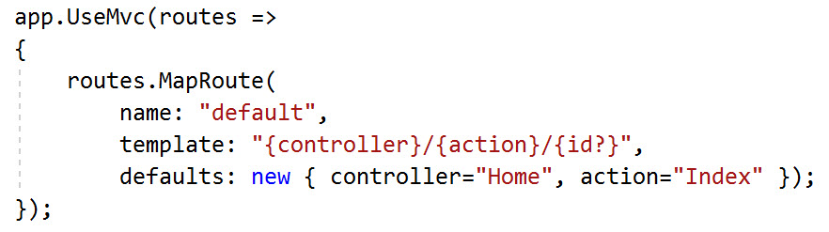
Define Routing
MVC invokes controller classes and the action methods within them depending on the incoming URL
/[Controller]/[ActionName]/[Parameters]
Specify the default route in Startup.cs
Or

Slide 25
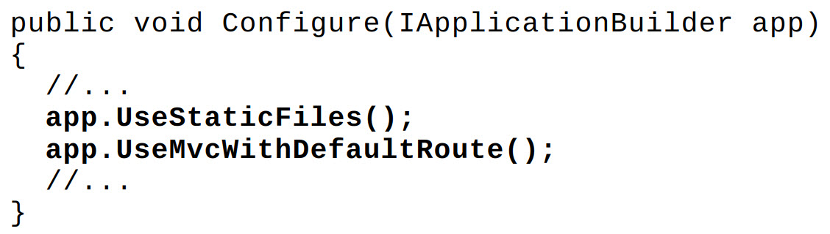
Another Way to Define Default Routes
Routing middleware is used to match the URLs of incoming requests and map them to actions
Routes are defined in startup.cs
Create the default route by invoking method UseMvcWithDefaultRoute() of IApplicationBuilder in StartUp.cs
With the above default route, the name of the controller type and the method name make up the route, e.g., http://server[:port]/controller/action or http://server[:port]/controller/action/id
The default name of the controller is Home; the default name of the action method is Index

Slide 26
View
Razor is a markup syntax for embedding server-based code into webpages. The Razor syntax consists of Razor markup, C#, and HTML. Files containing Razor have a .cshtml file extension
In MVC pattern, the view handles the app's data presentation and user interaction.
A view is an HTML template with embedded Razor markup which is code that interacts with HTML markup to produce a webpage that's sent to the client.
Normally, view files are grouped into folders named for each of the app's controllers, and the folders are stored in a Views folder at the root of the app

Slide 27
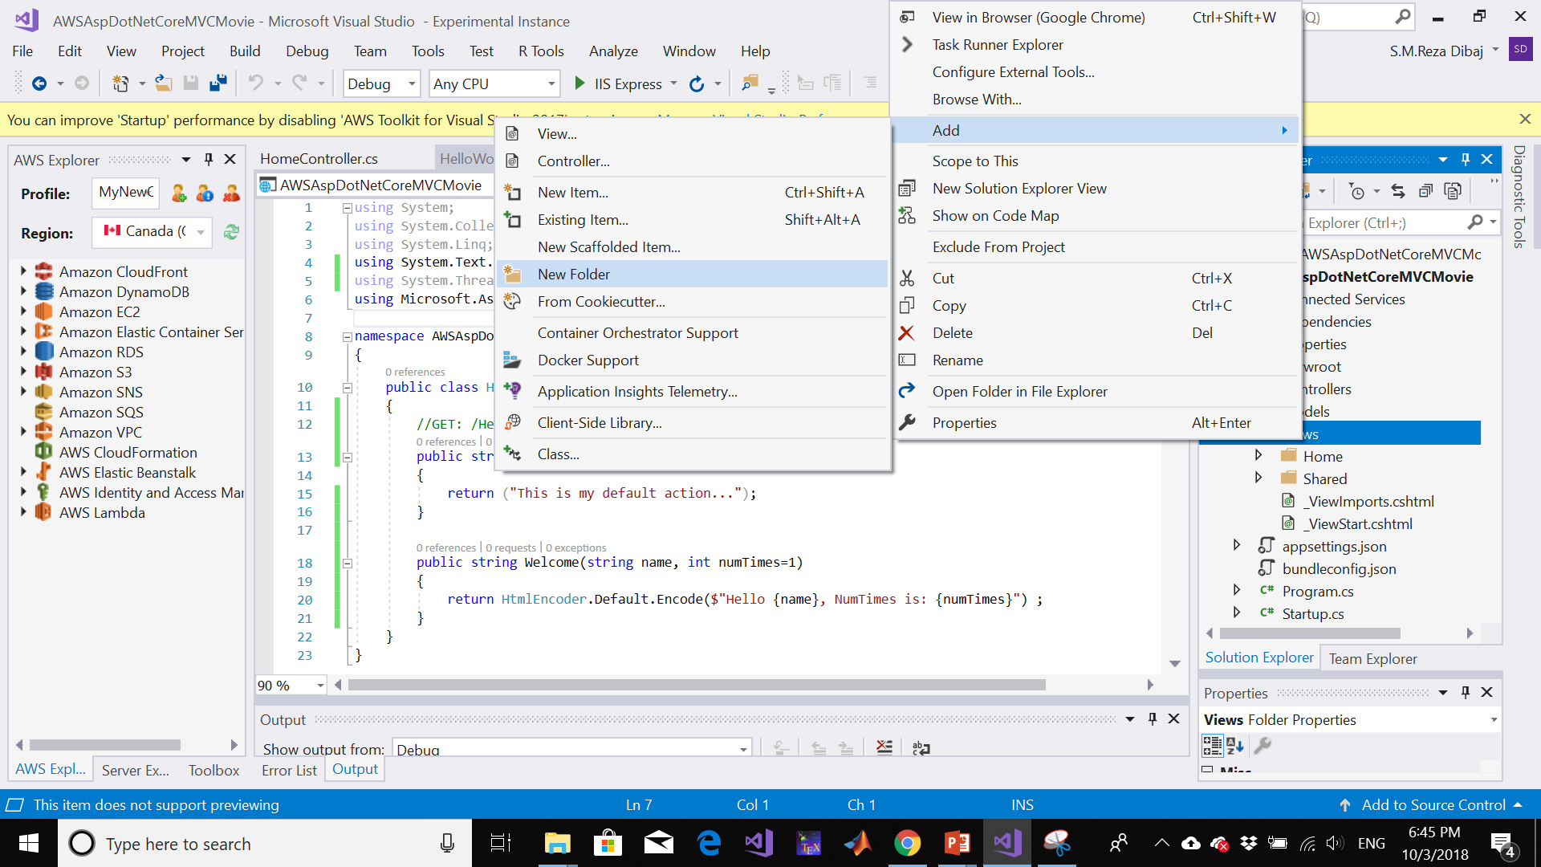
Add a Folder for our View

Slide 28
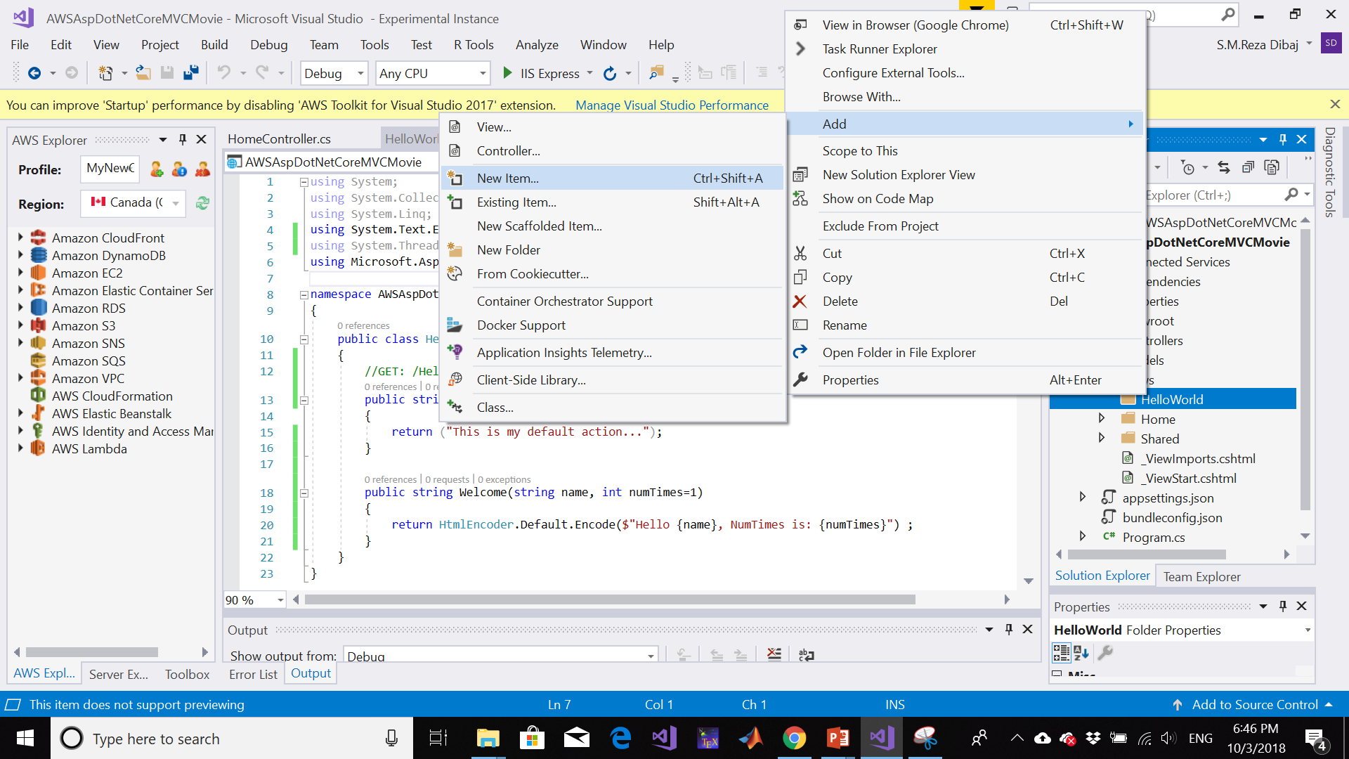
Add View

Slide 29
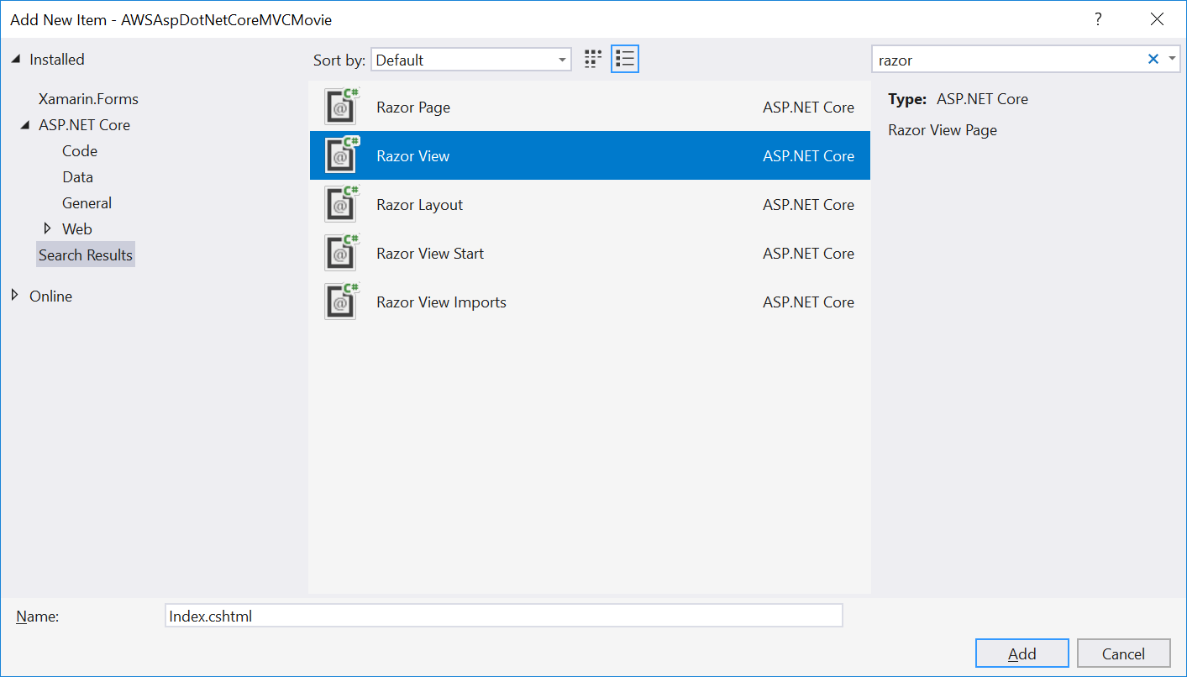
Add View

Slide 30
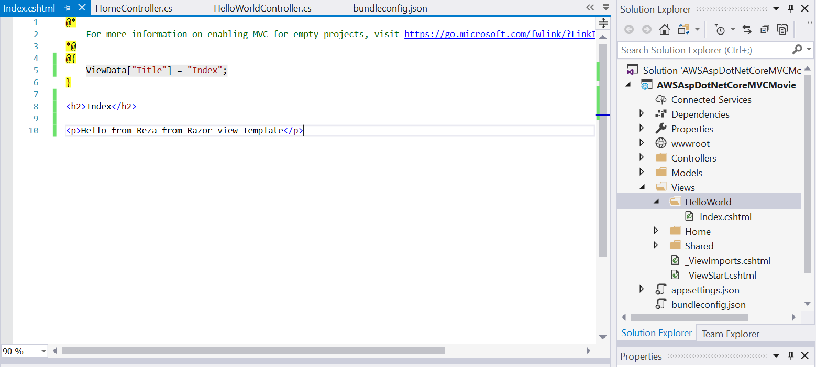
Add View

Slide 31
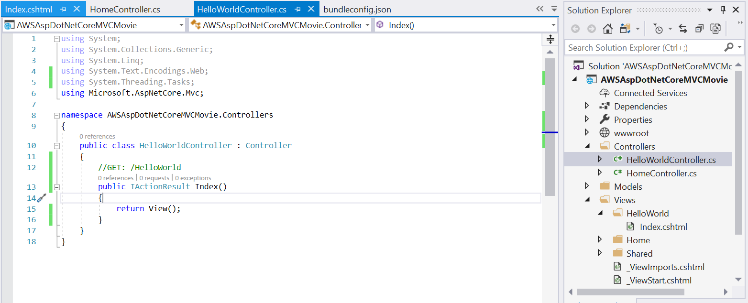
Add View
Notes:
using System;
using System.Collections.Generic;
using System.Linq;
using System.Text.Encodings.Web;
using System.Threading.Tasks;
using Microsoft.AspNetCore.Mvc;
namespace AWSAspDotNetCoreMVCMovie.Controllers
{
public class HelloWorldController : Controller
{
//GET: /HelloWorld
public IActionResult Index()
{
return View();
}
}
}

Slide 32
Let’s Run!

Slide 33
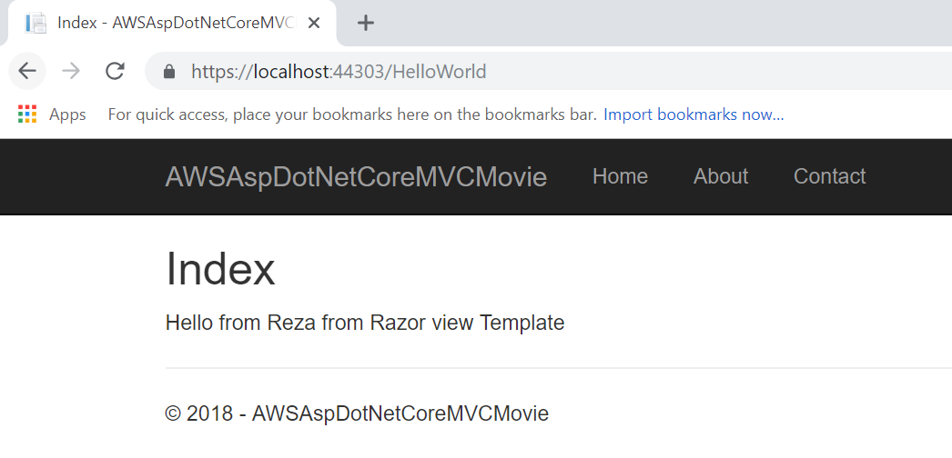
Result of the Adding a View

Slide 34
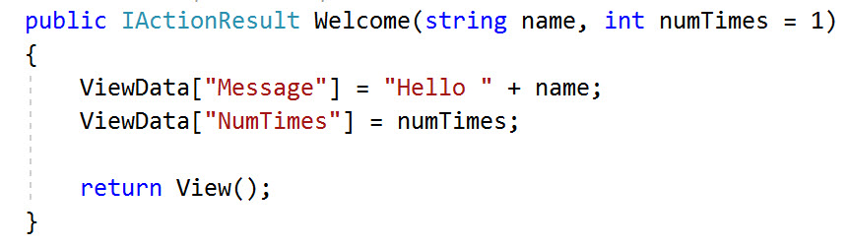
Pass Data from the Controller to the View
Controller is to handle the request, it retrieves data from a data source, generate response and send response back to the client.
Controllers are responsible for providing the data required in order for a view template to render a response, a view template should work only with the data that's provided to it by the controller.

Slide 35
Pass Data from the Controller to the View
ViewData dictionary is a dynamic object, and developer can put whatever he/she want. It has no defined properties until developer puts something inside it. The MVC model binding system automatically maps the named parameters (name and numTimes) from the query string in the address bar to parameters in the method.

Slide 36
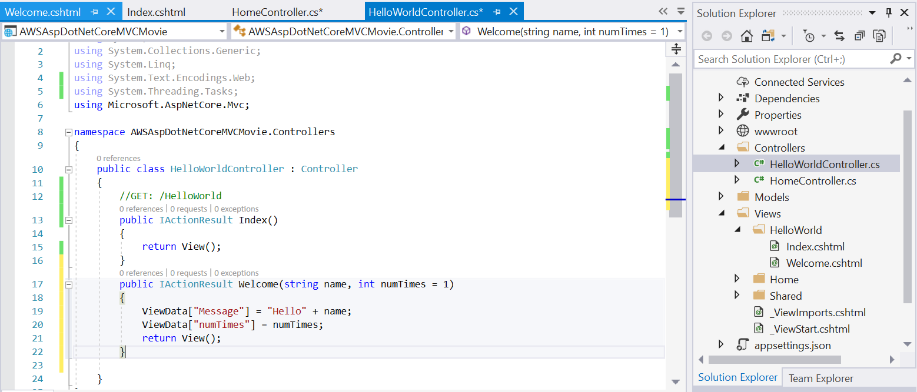
Modifying the HelloWorldController as follows:
Notes:
using System;
using System.Collections.Generic;
using System.Linq;
using System.Text.Encodings.Web;
using System.Threading.Tasks;
using Microsoft.AspNetCore.Mvc;
namespace AWSAspDotNetCoreMVCMovie.Controllers
{
public class HelloWorldController : Controller
{
//GET: /HelloWorld
public IActionResult Index()
{
return View();
}
public IActionResult Welcome(string name, int numTimes = 1)
{
ViewData["Message"] = "Hello" + name;
ViewData["numTimes"] = numTimes;
return View();
}
}
}

Slide 37
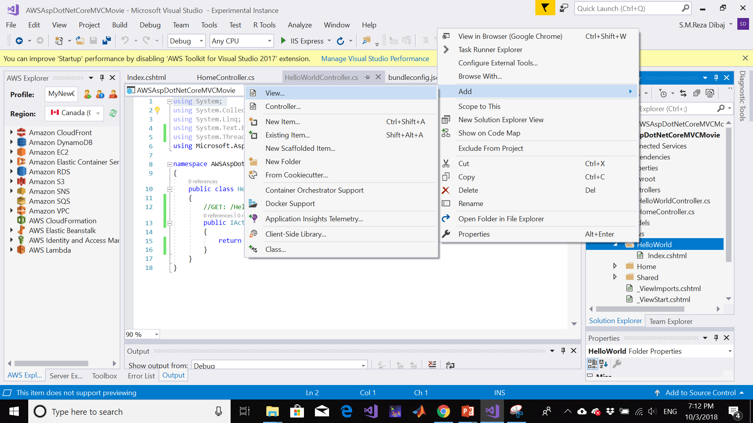
Add View

Slide 38
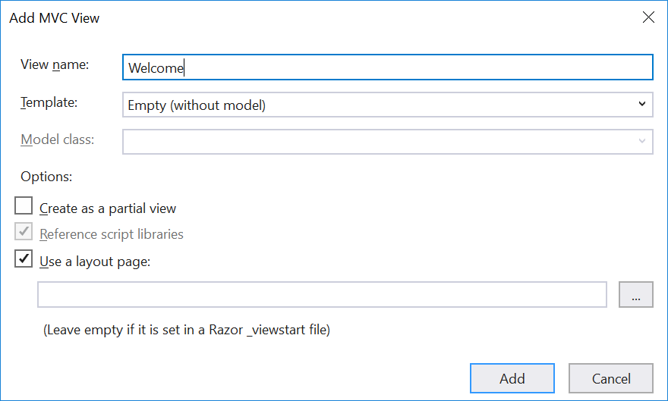
Add View

Slide 39
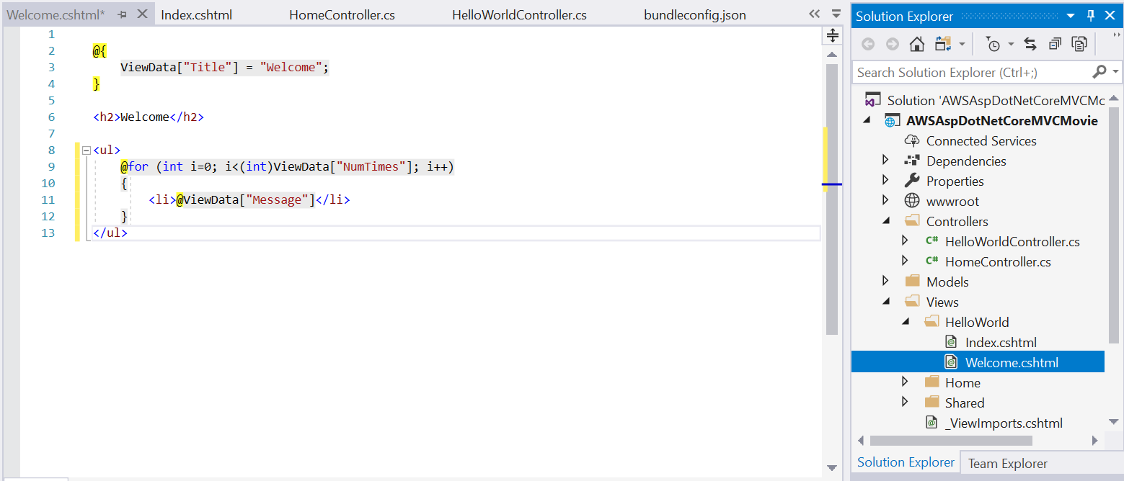
Add View

Slide 40
Let’s Run!

Slide 41
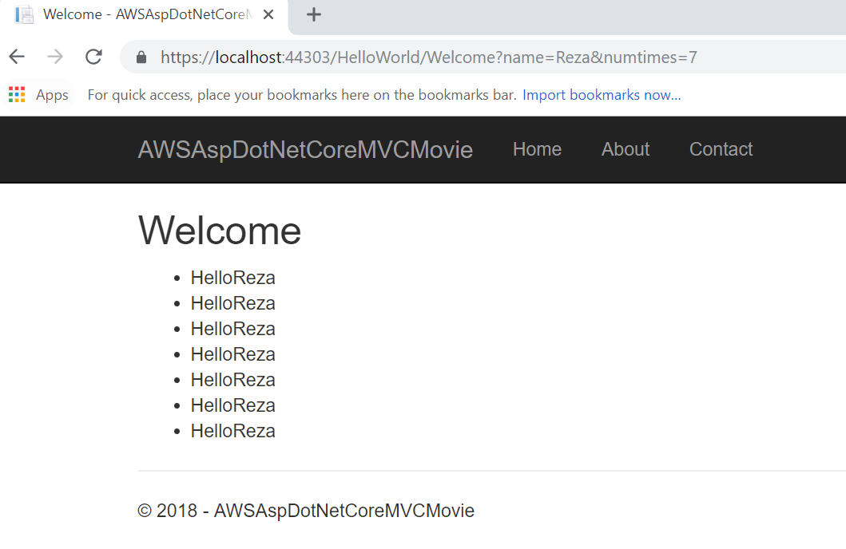
Result of the View

Slide 42
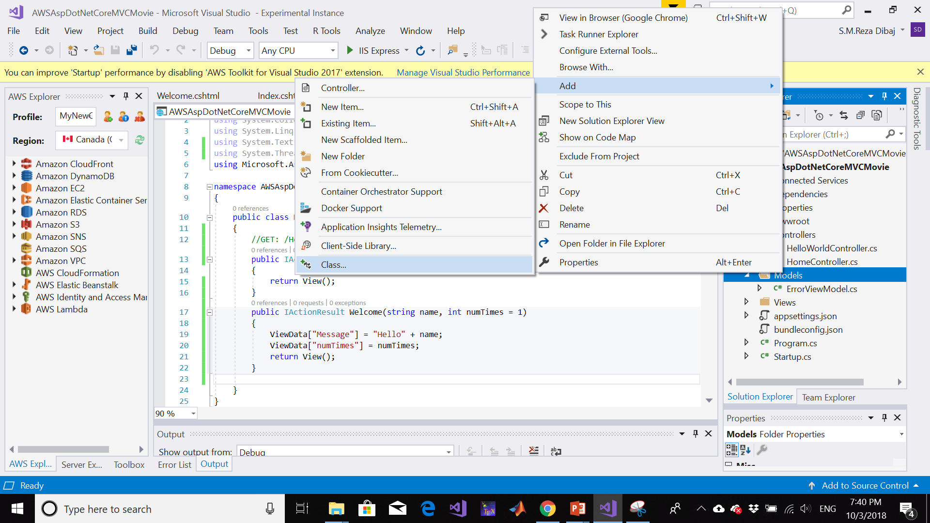
Add Data Model

Slide 43
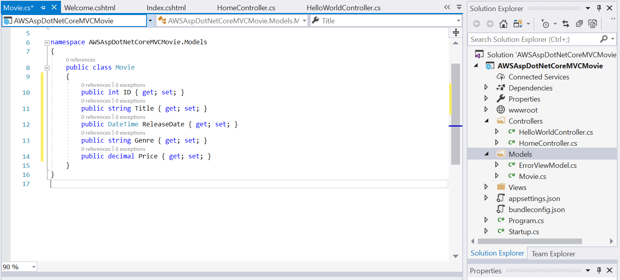
Add Data Model
Notes:
using System;
using System.Collections.Generic;
using System.Linq;
using System.Threading.Tasks;
namespace AWSAspDotNetCoreMVCMovie.Models
{
public class Movie
{
public int ID { get; set; }
public string Title { get; set; }
public DateTime ReleaseDate { get; set; }
public string Genre { get; set; }
public decimal Price { get; set; }
}
}

Slide 44
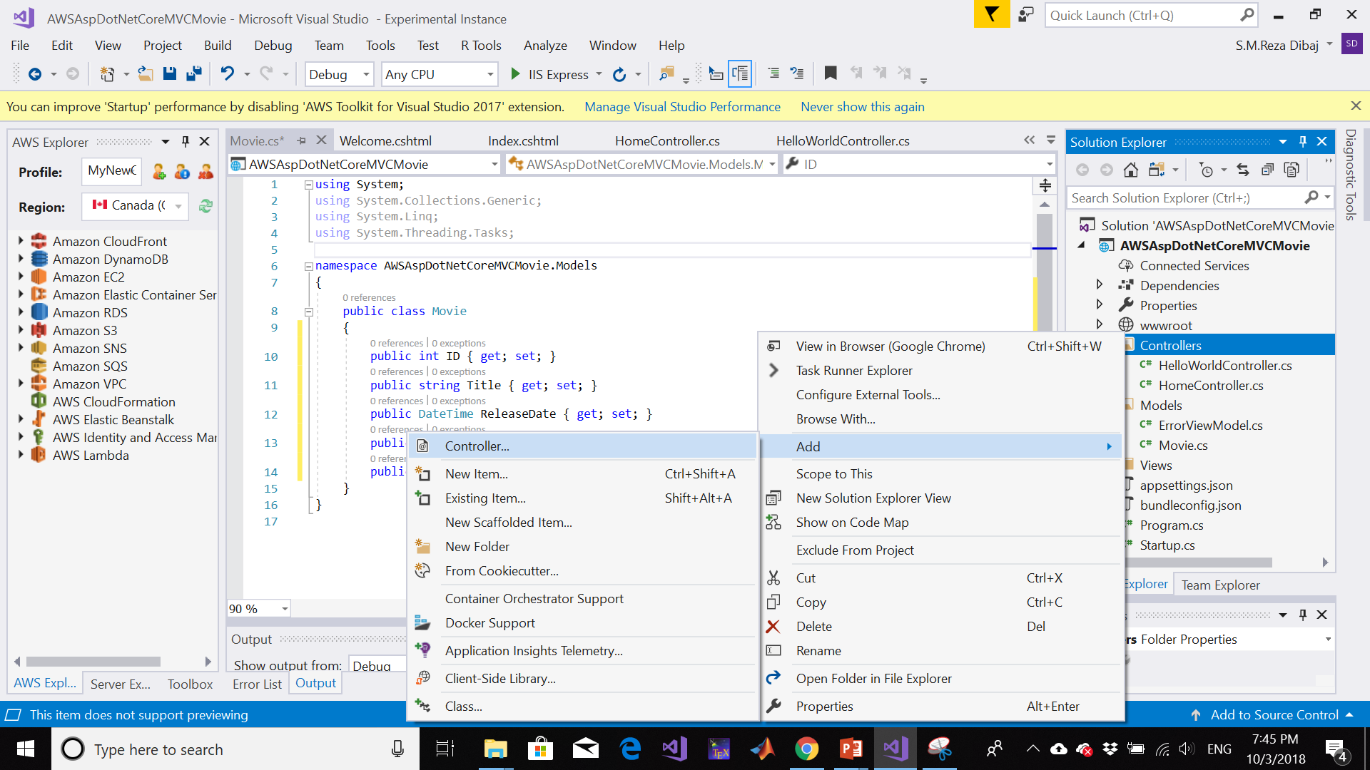
Add Controller

Slide 45
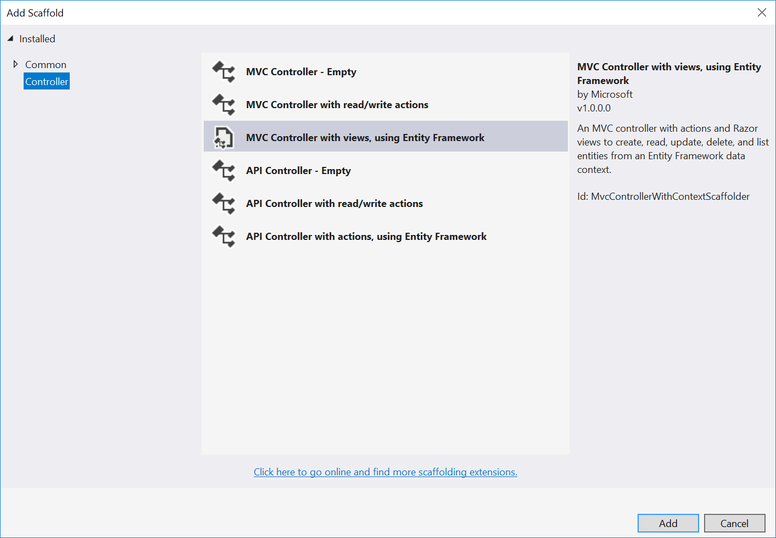
Add Controller

Slide 46
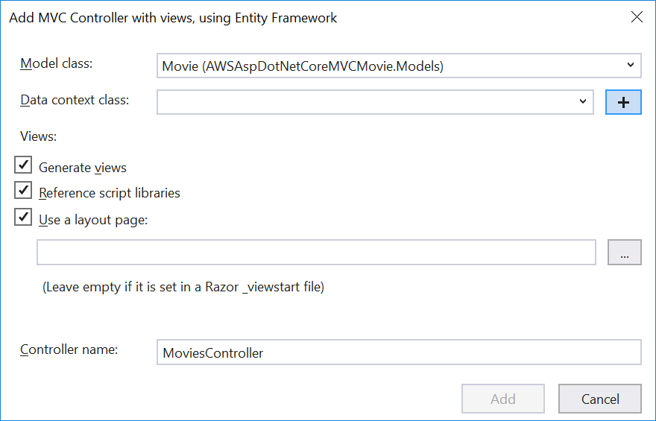
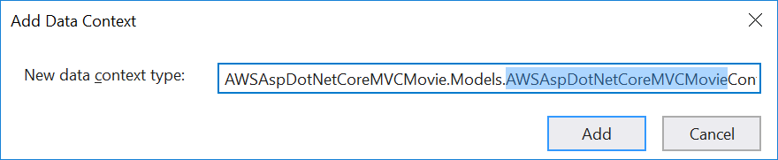
Add Controller

Slide 47
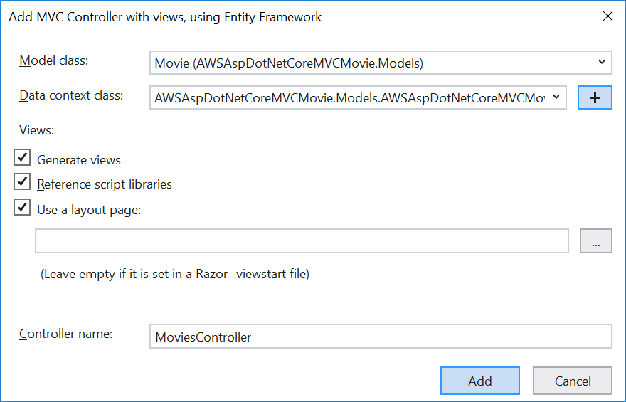
Add Controller

Slide 48
Add Controller
Visual Studio creates:
An Entity Framework Core database context class (Data/MvcMovieContext.cs)
A movies controller (Controllers/MoviesController.cs)
Razor view files for Create, Delete, Details, Edit, and Index pages (Views/Movies/*.cshtml)
The automatic creation of the database context and CRUD (create, read, update, and delete) action methods and views is known as scaffolding

Slide 49
Let’s Run!

Slide 50
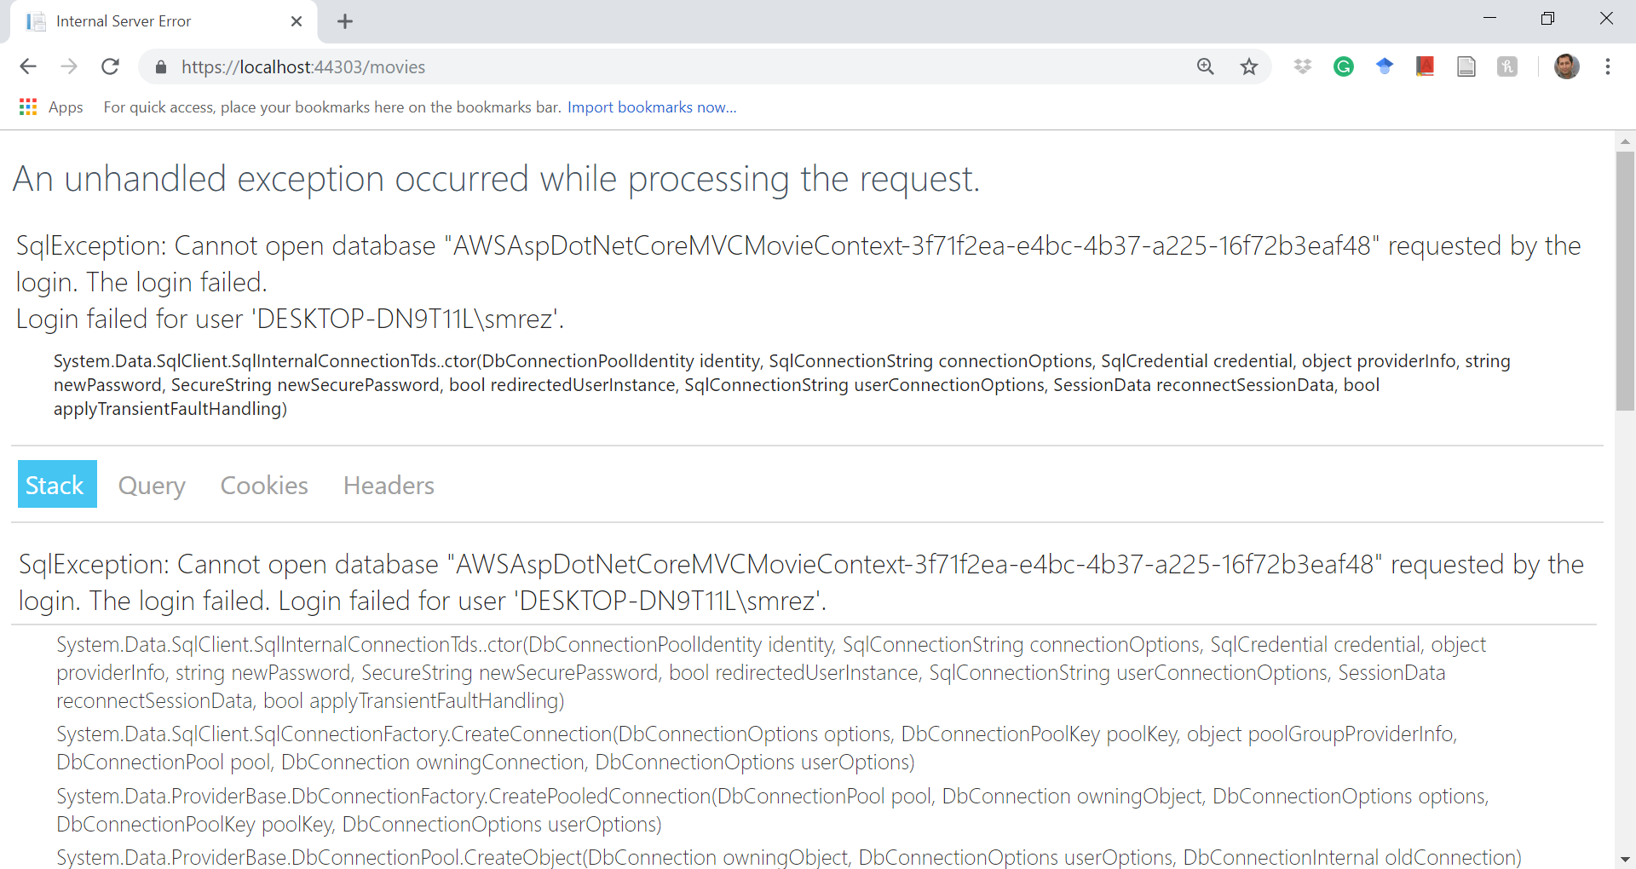
The Result of Running…

Slide 51
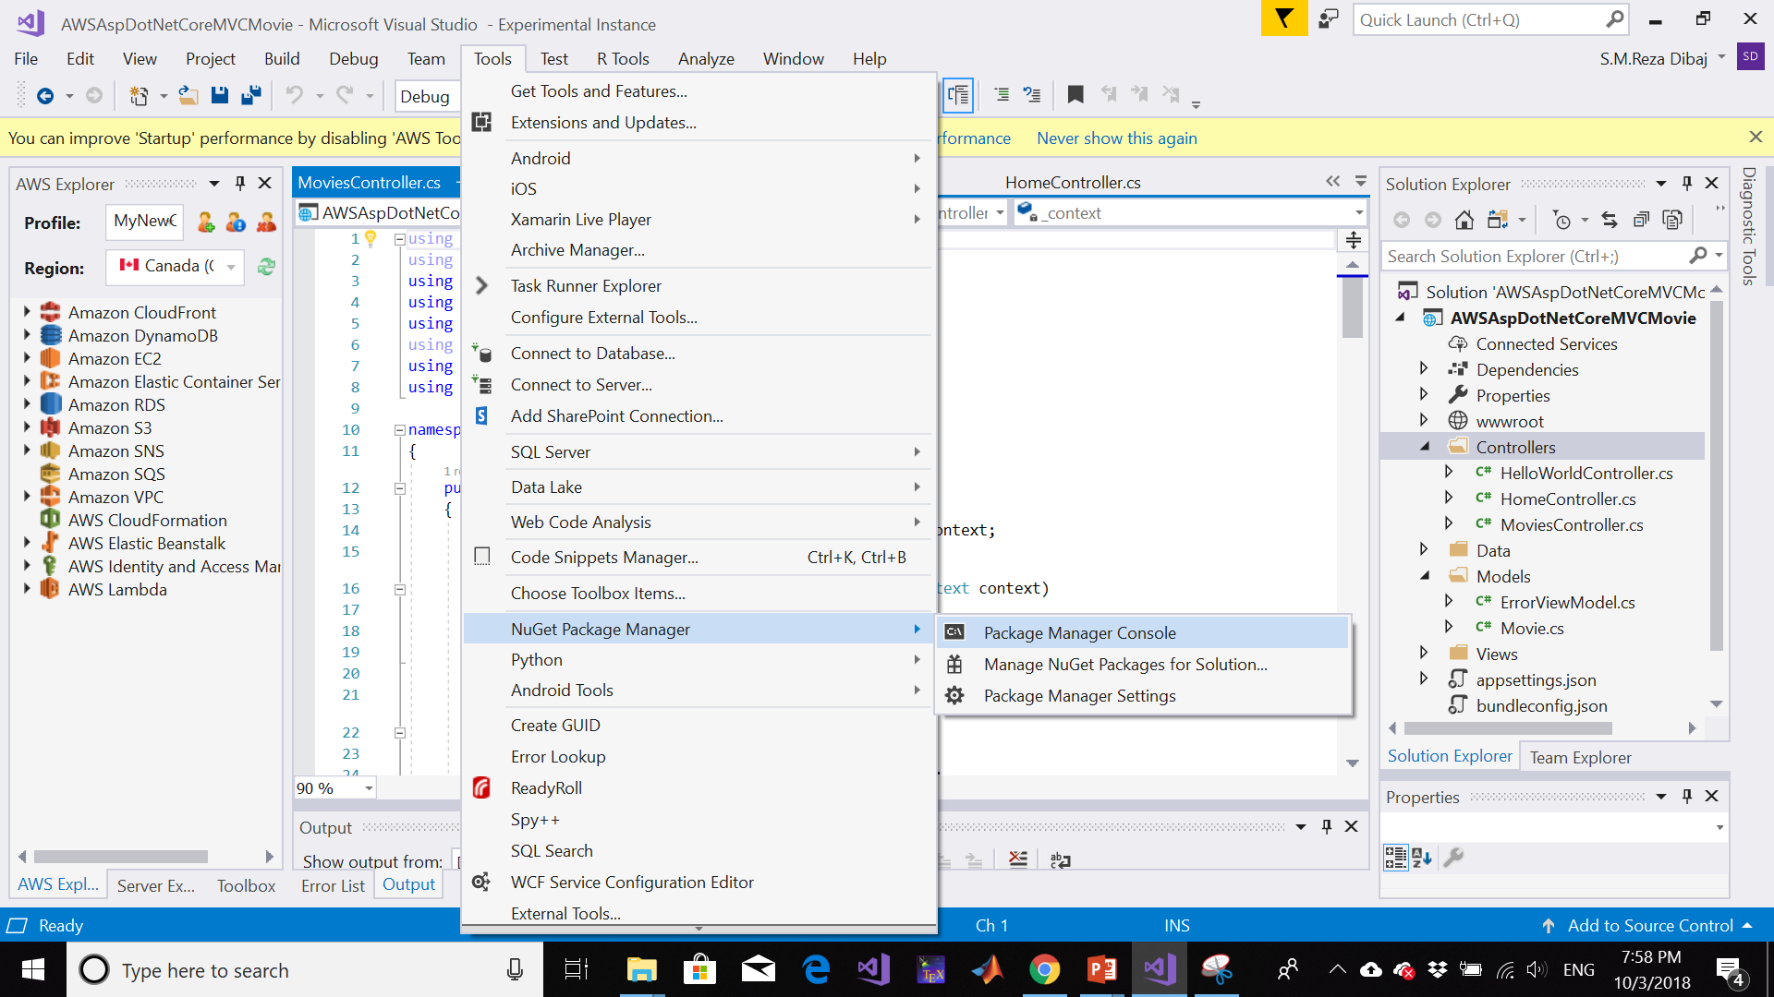
Add the Entity Framework

Slide 52
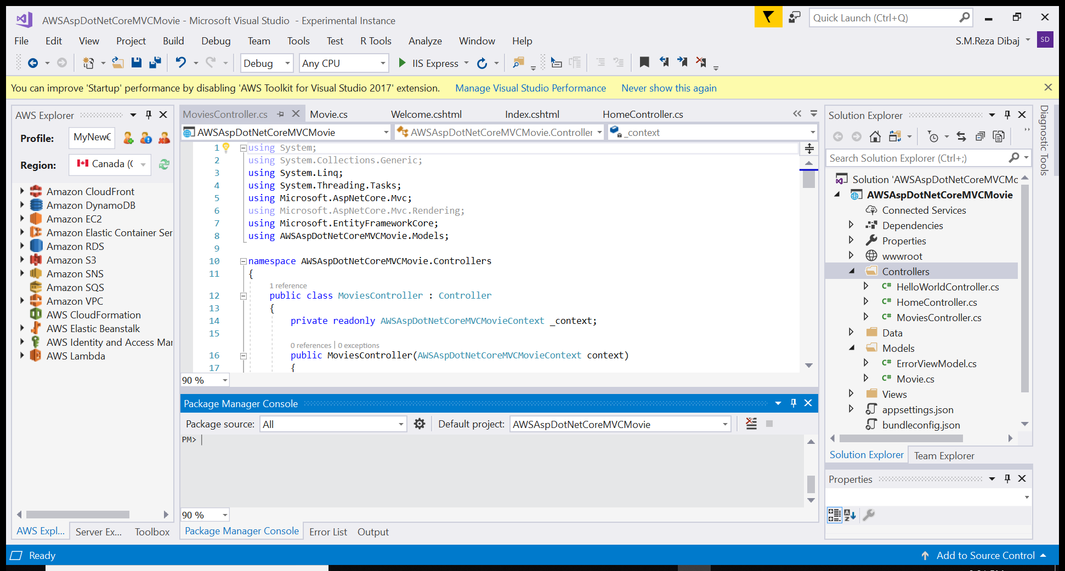
Add the Entity Framework

Slide 53
Perform Initial Migration
In the Package Manager Console (PMC), enter the following commands:
Install-Package Microsoft.EntityFrameworkCore.Tools
Add-Migration Initial
Update-Database
More information about PMC can be found here

Slide 54
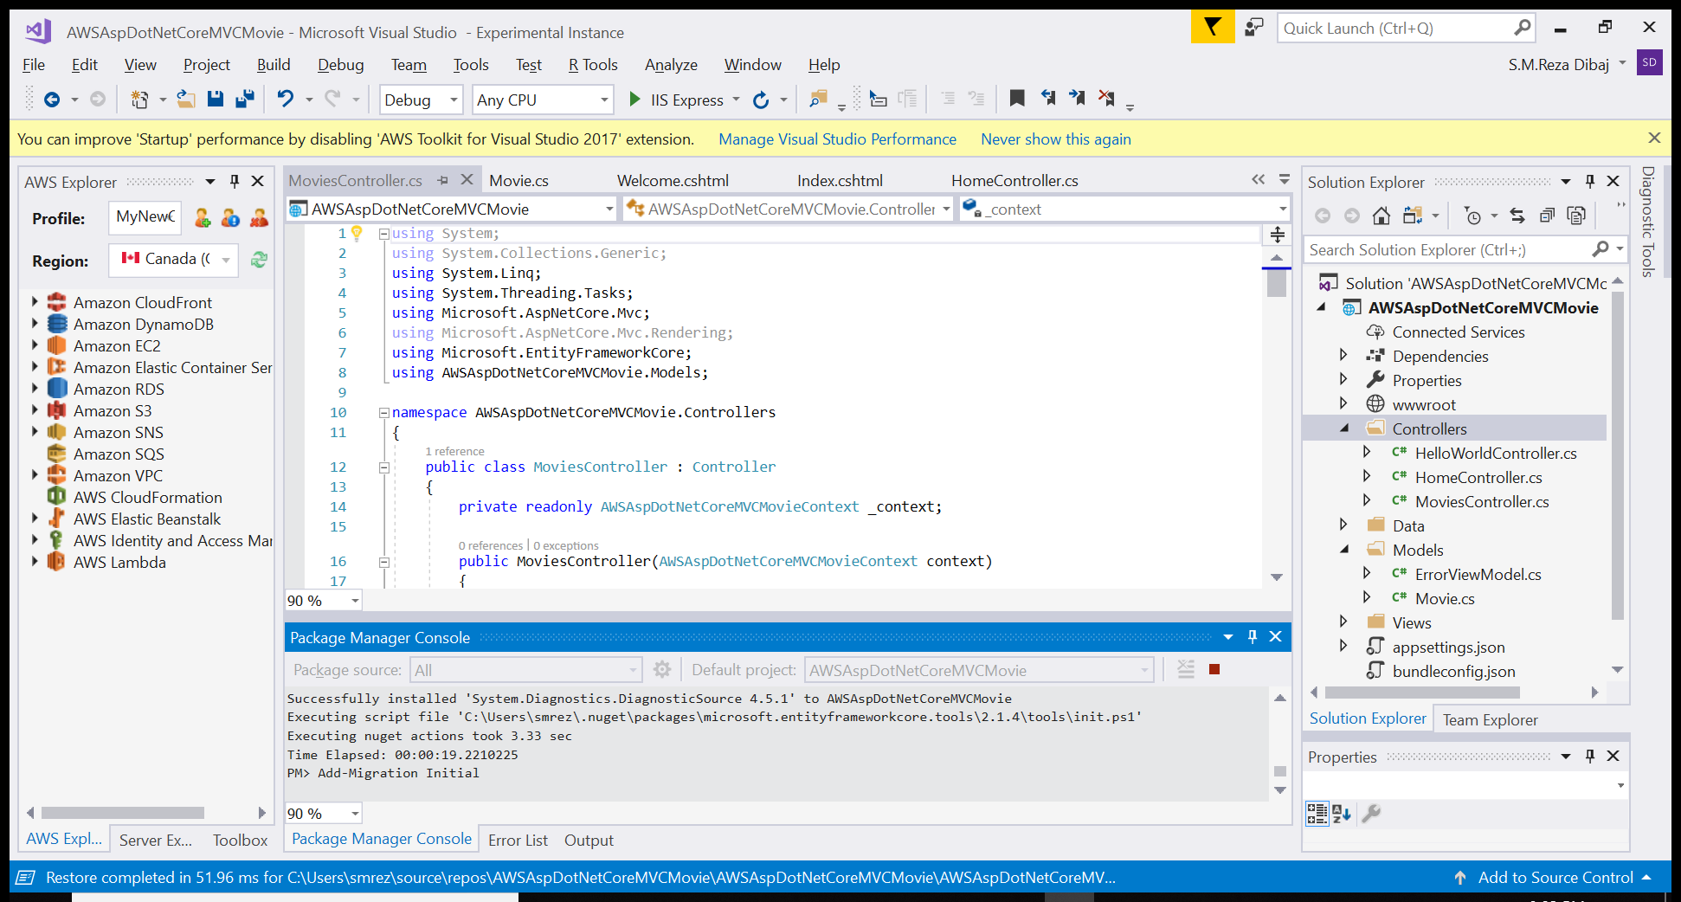
Add the Entity Framework

Slide 55
Let’s Run!

Slide 56
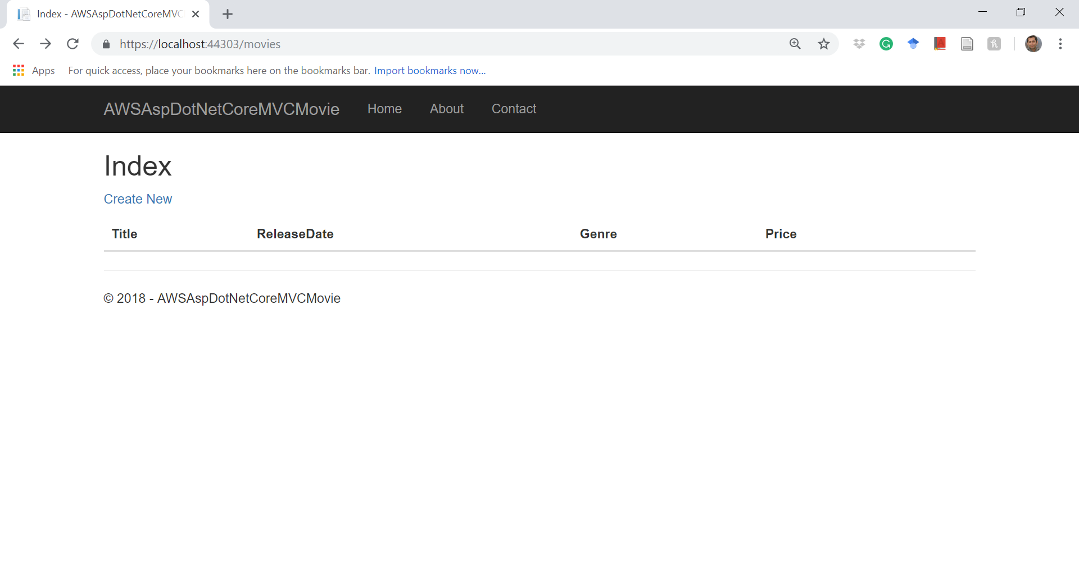
The Result of Running…

Slide 57
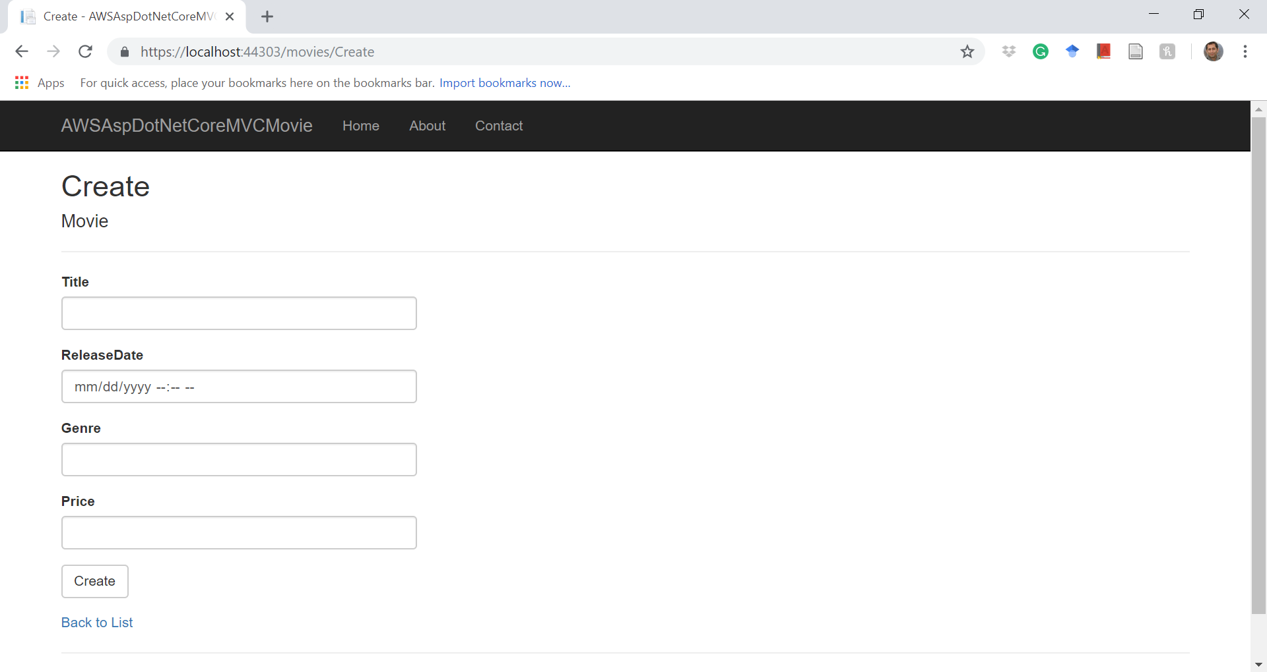
The Result of Running…

Slide 58
References
https://docs.microsoft.com/en-us/aspnet/core/tutorials/first-mvc-app/adding-model
https://docs.microsoft.com/en-us/dotnet/api/Microsoft.AspNetCore.Routing.IRouteBuilder?view=aspnetcore-2.0
https://docs.microsoft.com/en-us/aspnet/core/mvc/views/razor?view=aspnetcore-2.1
https://docs.microsoft.com/en-us/aspnet/core/mvc/views/overview?view=aspnetcore-2.1
https://docs.microsoft.com/en-us/ef/core/miscellaneous/cli/powershell

Slide 59
Thank you

